Slide 1
BIS 403 - Applied Systems Design College: Peirce College Professor: Robert Heubner Group Members: J. Sherif & M. Morrison Case Study: Personal Trainer Final Presentation
Date: 2/25/2024

Slide 2
Case Study #7
(Personal Trainer)

Slide 3
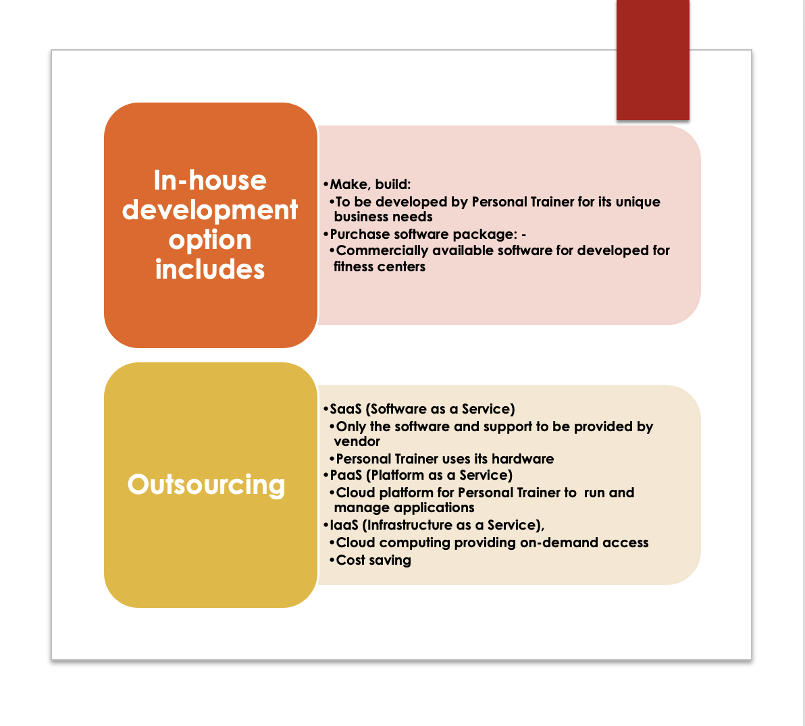
List of Options For Developing A New System

Slide 4
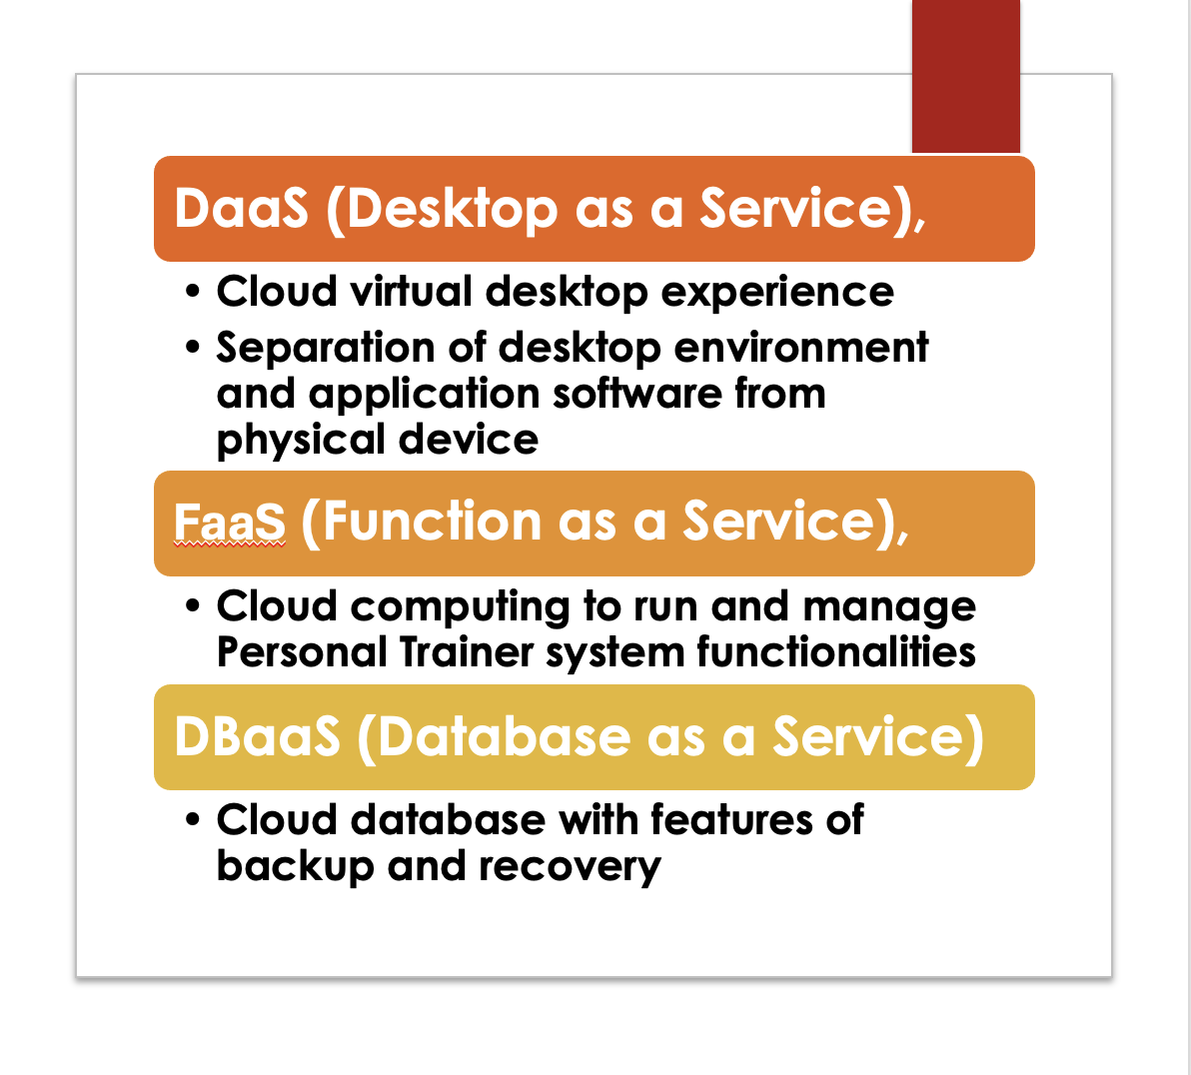
Options For Developing A New System (CTD)

Slide 5
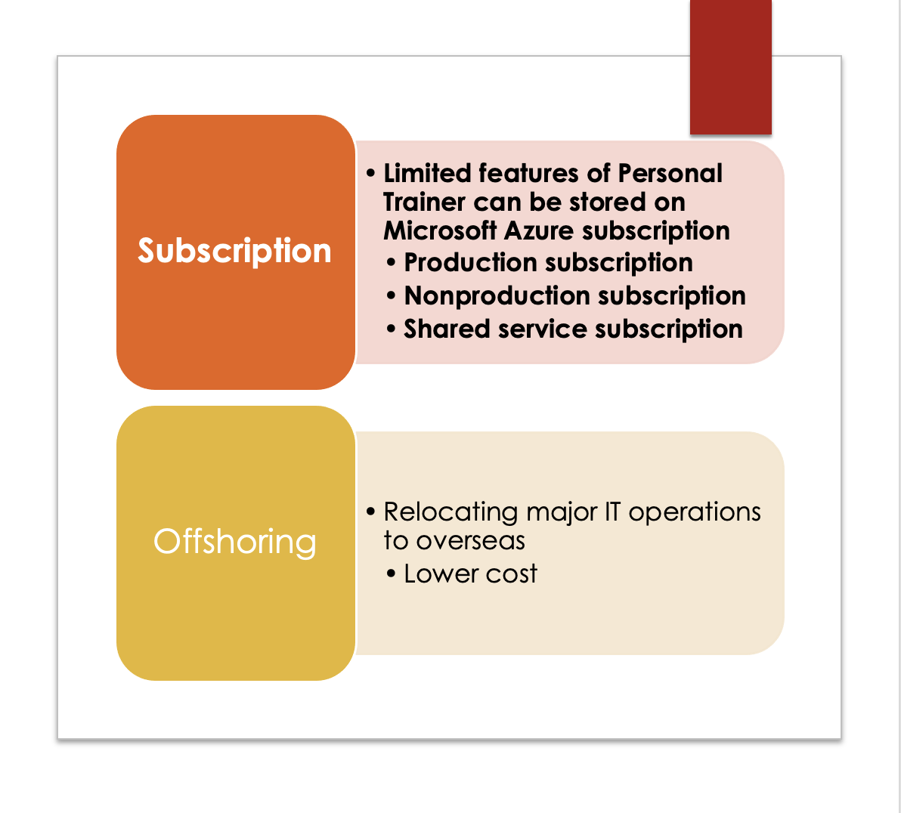
Options For Developing A New System (CTD)

Slide 6
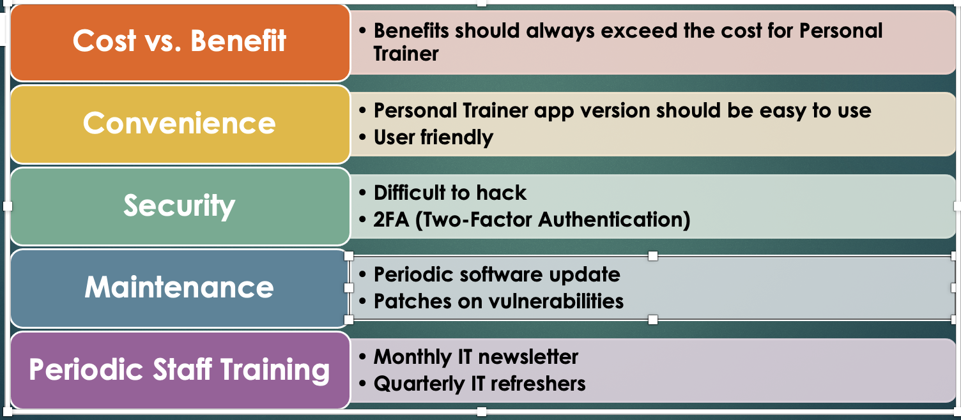
Specific Issues & Options To Consider

Slide 7
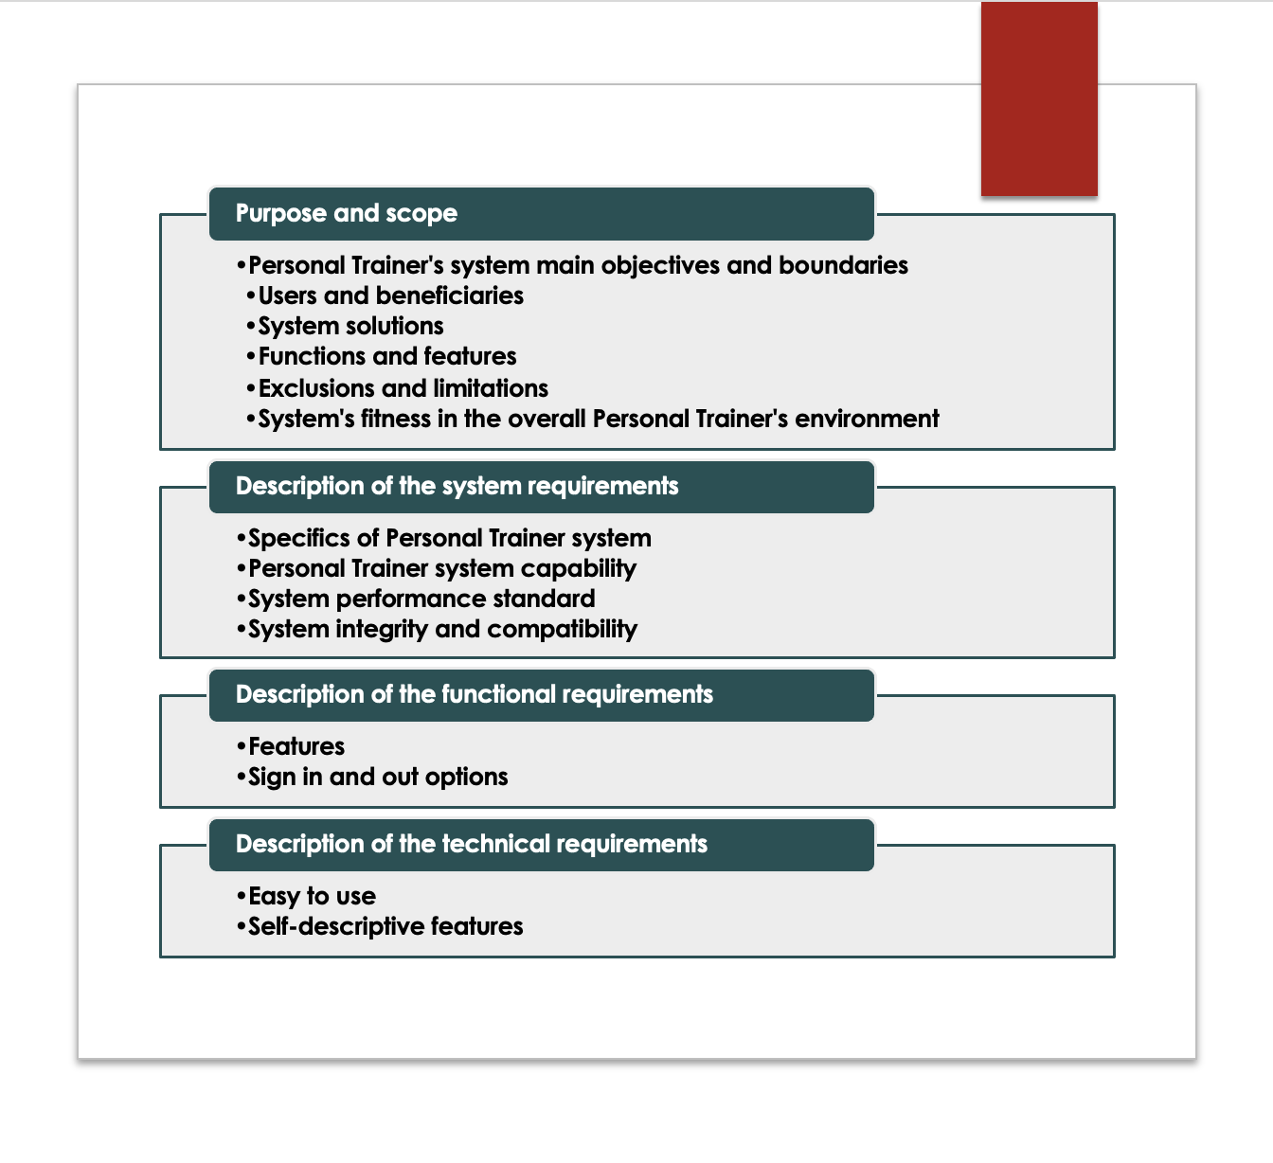
Main Elements Of The System Requirement Document

Slide 8
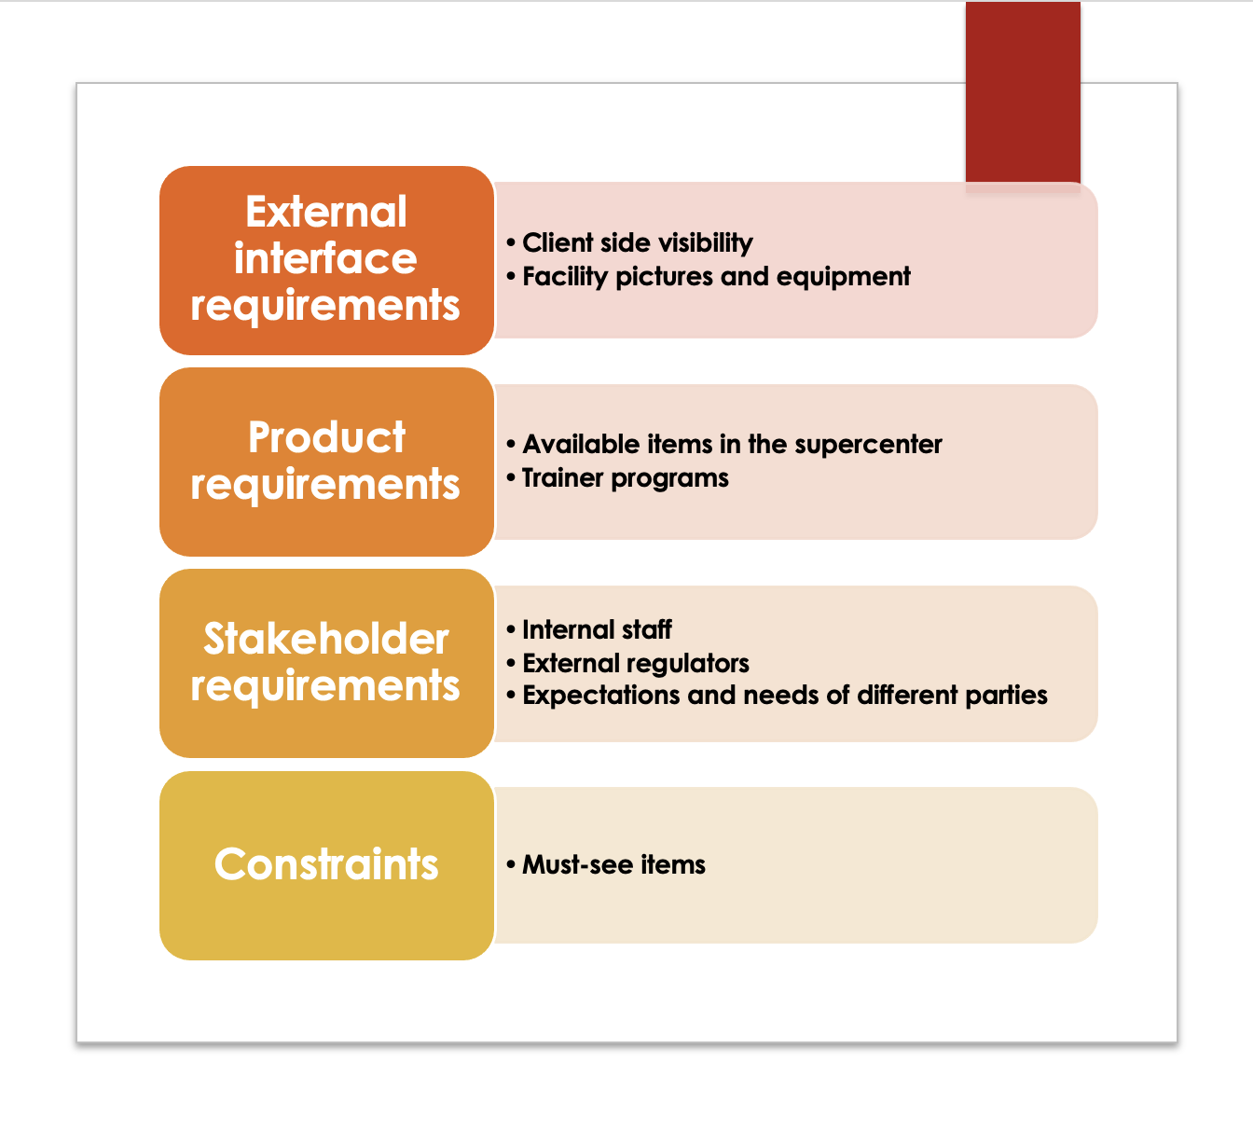
Main Elements Of The System Requirement Document

Slide 9
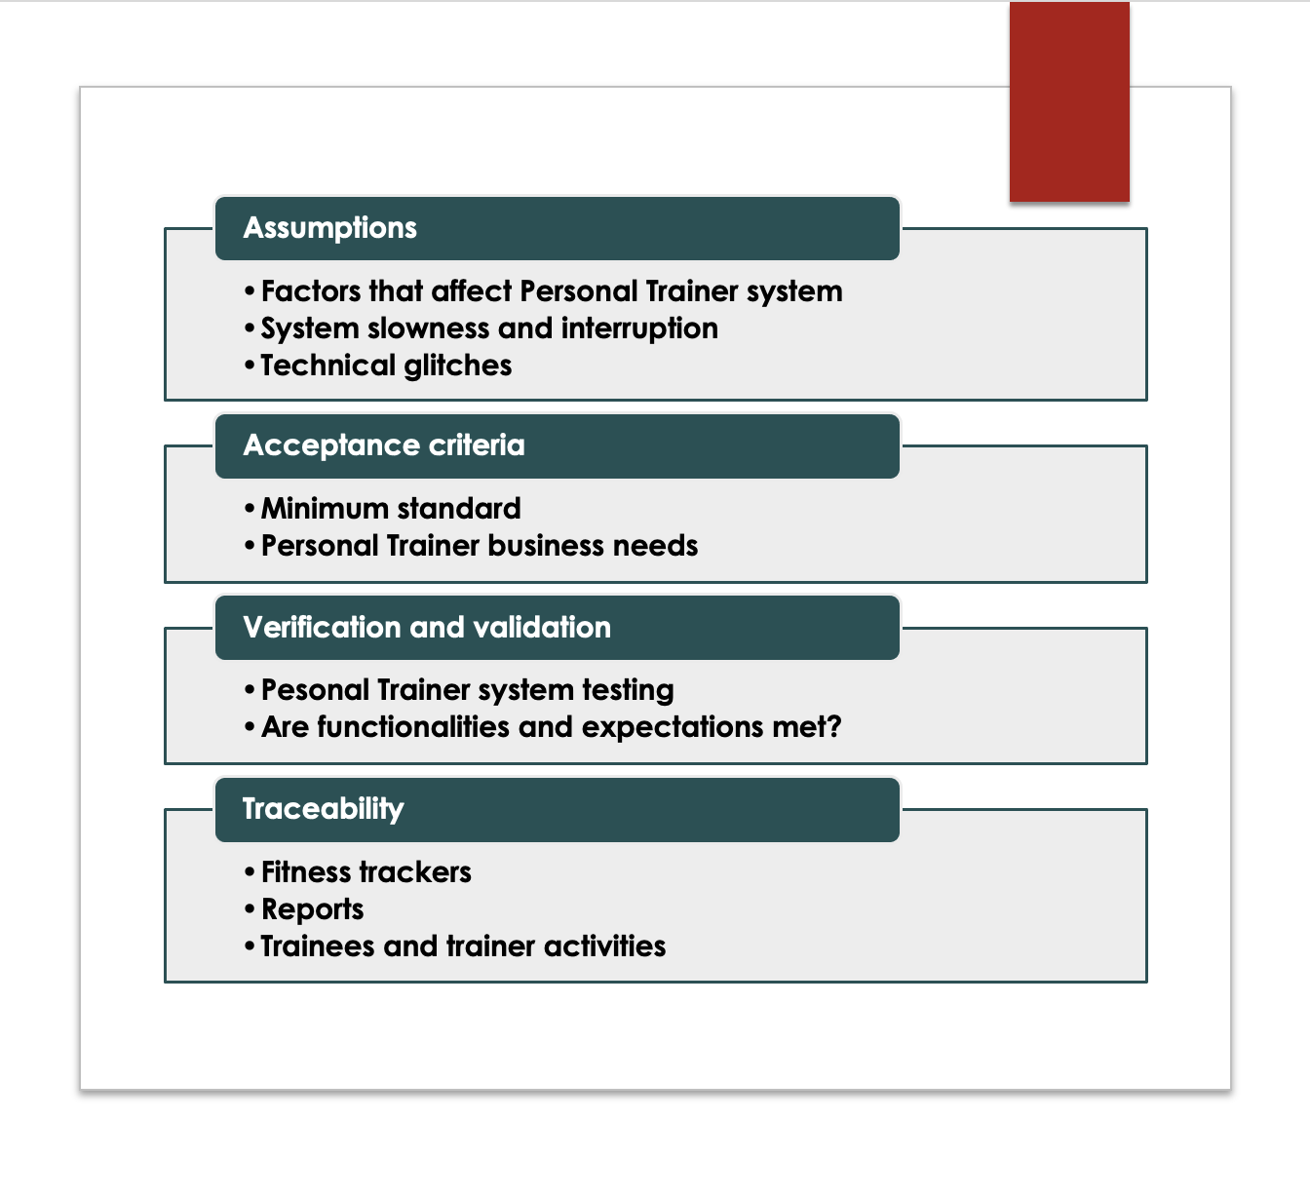
Main Elements Of The System Requirement Document

Slide 10
Utilization Of Visual Aids
Visual Aids serve as a medium to demonstrate a concept, idea or product.
Video visual aids can be extremely effective, giving those who watched the presentation a lasting memory of what was shown.
Video visual aid should be utilized to show the system.

Slide 11
Total Cost Of Ownership
Total cost of ownership is determined by the price of the asset in questioned in addition to operational costs of a certain value of time
This is crucial in determining the economic feasibility of a project before it is started.
Various financial tools are available to calculate TCO. However they all come with Pro’s and Con’s.
Only one method is correct to accurately calculate TCO in this scenario.

Slide 12
Financial Analysis Tools (Pros & Cons)
Payback Analysis
Ignores Time of Value
Ignores Cash Flows Beyond The Payback Period
Easy To Calculate
Shorter Payback Period
ROI (Rerun On Investment)
Focuses Only On Financial Impact, Disregards Non Financial Benefits
Need To Thoroughly Understand All Project Related Expenses
Easiest To Calculate
Can Apply To Short Term & Long Term Projects
Present Value Analysis
Accuracy Depends On Quality Of Inputs
Short Term Focused
Incorporates Time Value Of Money (Inflation, Interest Rates)
Excellent Way To Predict Value Outcomes

Slide 13
Optimal Tool To Calculate TCO
The optimal way to calculate TCO is to utilize the TCO formula.
The TCO formula consists of the following formula I + M – R = TCO.
Initial cost (I), Maintenance costs over 3 years (M), and the remaining value after 3 years of depreciation (R).

Slide 14
Case Study #8
(Personal Trainer)

Slide 15
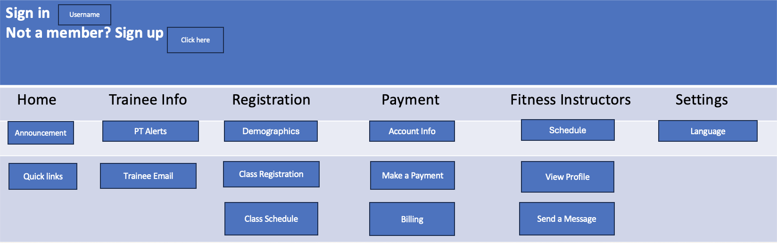
Personal Trainer Switch Board

Slide 16
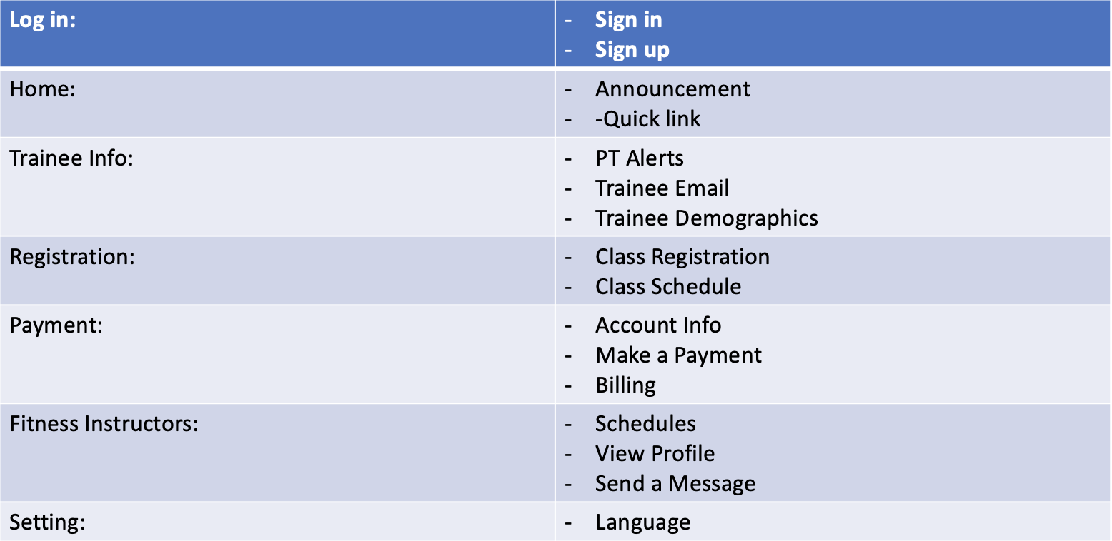
Personal Trainer Storyboard

Slide 17
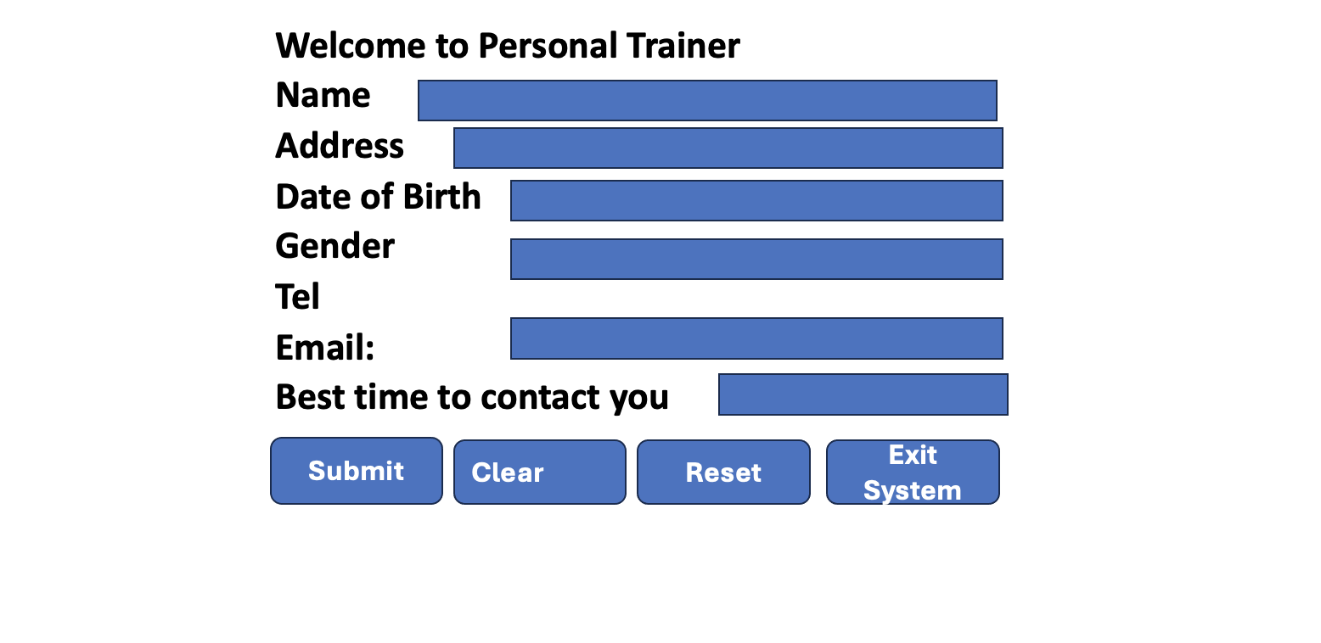
Personal Trainer Online Registration Form

Slide 18

Paper Source Document (Fitness Class Sign Up)

Slide 19
BumbleBee Software Data Protection & Security Controls (Memo)
DATE: 2/11/2024
TO: Gray Lewis & Personal Trainer Staff
FROM: Susan Park
SUBJECT: Bumblebee Software Data Protection & Security Controls
Greetings Personal Trainer Staff,
In today’s business environment, the protection and control of data is paramount to an organization's daily operation. Also, with businesses utilizing a technologically centric approach to the input, output, and storage of this data, it is even more imperative that this data is controlled and accurate. Listed below are the various controls and policies that will be implemented in order to adhere to the fundamental principles of data security in a modern business environment.
Input Security Controls
Data Entry Audit Trail - Each time data is entered into the system, an audit log line will be recorded that shows what was entered, by whom, the date and time, as well as how long the user took to enter that data.
Input Access - All users have the ability to input data within the system. This input will be reconciled daily for accuracy.
Output Security Controls
Report Generation & Printing - Printing & Scanning can only be completed within the facility secure team member office. Each report that is generated and printed is tracked. Financial and payroll reports are only accessible to the facility’s manager and can not be printed. Only read. Other reports such as sales transactions and membership information can be viewed and printed. Print counts will be enabled on each report to limit the amount of physical copies that can be accessible at once.
Removable Devices & External Access - It is prohibited to move company reports to external hardware such as a flash drive. It is also prohibited to store any company reports on a team member’s email account or cloud storage service. The only email domain that is accessible will be Personal Trainer’s. Also the only cloud storage service that will be available is google drive. External USB ports will be blocked to prevent any intrusions from threat actors as well as deter the transfer of company information on to an external USB drive.
Data Security Policies
Record Retention Policy - All physical records of all transaction will be digitally scanned and saved to the facilities designated file share drive. These records will then be backed up and stored in Personal Trainer’s AWS S3 bucket for future reference if needed. Records up to one year will be accessible on the file share drive. After one year, all records will be cleared. The facilities admin will be responsible for all scanning and data entry.
Physical Transaction Destruction - Once a record is scanned, place the physical document in side of the manager’s office in the designated physical destruction bin. After each day, the facility manager will be responsible for shredding all of the documents that are placed in the bin.
Identity Access Management - Access to the various reports and information provided within the BumbleBee Software System will be based off of Security Groups that are assigned to the facility employee. There will be four levels of access, Level 1 (Facility Sales Clerk), Level 2 (Facility Admin), Level 3 (Facility Trainer), Level 4 (Facility Manager). These levels of access correspond to the job roles that each team member may have.

Slide 20
Case Study #9
(Personal Trainer)

Slide 21
Normalization in Data Design Context
Creating table designs by assigning specific fields or attributes
Involves identification of a primary key in a table
A process for avoiding problems in data design
Normalization stages: • Unnormalized design
Aka raw data or non-first normal form
A table with repeating groups

Slide 22
Normalization in Data Design Context (ctd)
• First Normal Form (1NF)
Elimination of repeating group
Inclusion of primary key of the repeating group
• Second Normal Form (2NF)
Functional dependency of all fields after 1NF
• Third Normal Form (3NF)
Redundancy avoidance after 2NF

Slide 23
Personal Trainer - ERD
Instructor
Name
Schedule
Trains
Name
Email
TRAINEE
Address
Buys
Takes
Merchandise
CLASS

Slide 24
Personal Trainer Database Design
The Following Four Slides give a brief visual representation of the various tables that will be utilized to store company data & information.
Primary & Foreign Keys will be utilized to promote 3NF as well as provide links to other tables via Join queries.
Microsoft SQL Server will be hosted within AWS, relevant databases will be created with relevant tables to promote organization and ease of use.
Example data will be presented for three of the tables.

Slide 25
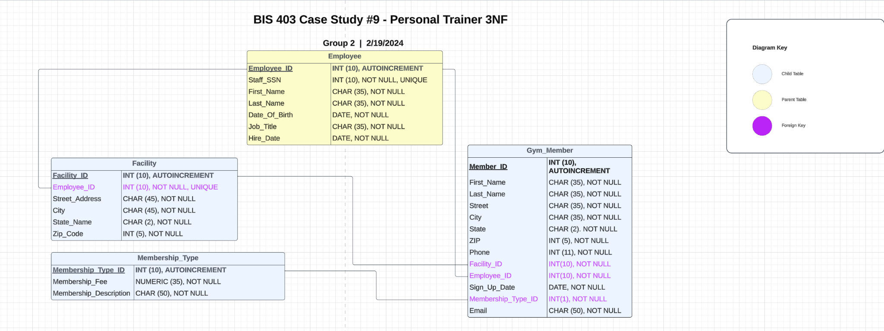
Personal Trainer 3NF Database Design

Slide 26
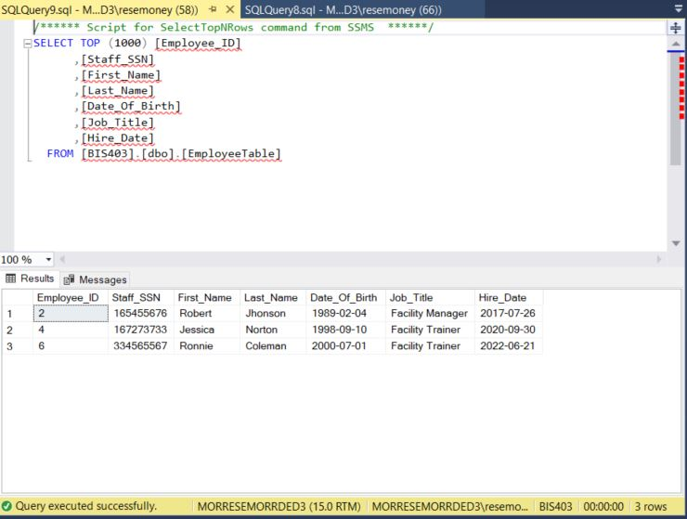
Personal Trainer 3NF Database Design (Employee Table SQL Screenshot)

Slide 27
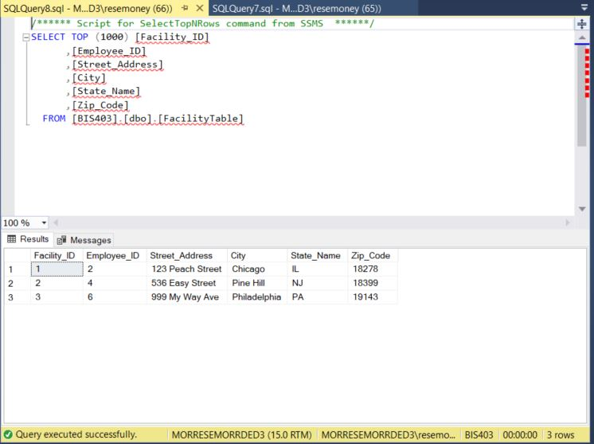
Personal Trainer 3NF Database Design (Facility Table SQL Screenshot)

Slide 28
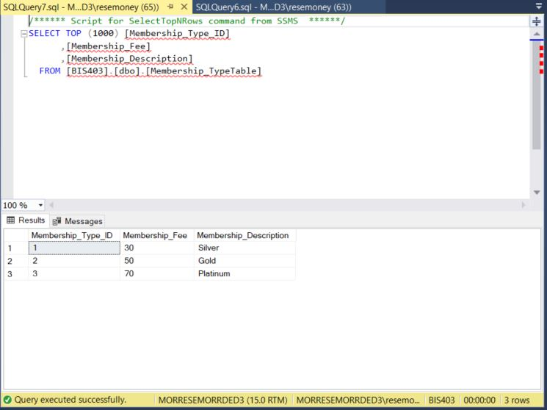
Personal Trainer 3NF Database Design (Membership Type Table SQL Screenshot)

Slide 29
Case Study #10
(Personal Trainer)

Slide 30
Advantages of Internet-based Architecture
Decentralization
Fault tolerance advantage
Server distribution
Scalability (Extensibility or downsizing)
Protocols
HTTP protocol
TCP/IP protocol
Client-Server Model
Web servers
Fat (thick) client option
Thin client option

Slide 31
Advantages of Internet-based Architecture
RESTful APIs
Interaction between services over the Internet
Security Considerations
Authentication
Data privacy
Vulnerability
Patches
Incident response
Periodic testing
White hat hacking
Gray hat hacking
Black hat hacking

Slide 32
Advantages of Internet-based Architecture
Lower hardware cost and complexity
Web server provision of entire user interface
Cloud computing with convenience
Less compatibility issues
Scaling on demand

Slide 33
To increase Internet marketing
Search Engine Optimization (SEO)
Higher rank in search engine results
Easy to remember key words
Links
Content Marketing
Engaging videos
Valuable blogs
Relevant infographics
Social Media Marketing
Facebook, Twitter, Instagram, LinkedIn
Content sharing
Brand promotion

Slide 34
To increase Internet marketing
Email Marketing
Email list preparation
Follower engagement
Targeted ad
Web Design
User friendly with a look and feel
Visually appealing
Responsive to mobile devices
Reputation Management
Responding to user feedback
Image building
Remaining competitive

Slide 35
Software & Hardware Infrastructure (POS)
DATE: 2/19/2024
ITEM: Software & Hardware Infrastructure Point Of Sale Requirements
Narrative: Proper set up and implementation of the infrastructure is paramount for the processing of all point of sale transactions at each Personal Trainer facility. Listed below is the infrastructure that will be implemented and installed to confirm POS accessibility.
Hardware Infrastructure:
Network: Implementation of Fortinet and Aruba network gear
Fortigate (60F/61F) Firewalls
Fortinet (9FS-548D-FPOE) Switches
Aruba (FS-AP3000C) Access Points
Cat 6 POE
Computers: Implementation Of User equipment.
HP (EliteBook 860 G10 Notebook)
Peripherals: Implementation of Peripherals
HP Thunderbolt Docking Station (Secure Lock)
POS Scanning Equipment
Software Infrastructure
Software Package: Acquisition & Implementation of POS Software
POS License & Software Purchase
Windows 11 License Purchase
POS Web Portal Access Per User Device

Slide 36
System Design Specification Outline
DATE: 2/19/2024
Management Summary - Proposed new information system to effectively manage and maintain Personal Trainer’s rapidly growing customer base as well as being in position for future company
endeavors.
Benefits: Able to encompass and process all areas of the business and able to provide future proofing features at a reduced cost of ownership post implementation.
Schedule: 1/8/2024 - 6/13/2024.
Development Efforts: Current and future business model has been ingested and documented to align with the new information technology system. Data processing, security and etc.
System Components - All relevant system components of the new system.
Databases - AWS Microsoft SQL Server to hold several databases (Accounting, Operations, Sales, Customers).
User Interface - Video recording of the working UI/UX, completing various processes within the system to demonstrate easeasibility.
Network - Star network topology will implemented and refreshed to confirm fast packet sending and receiving on various devices.
Security - System access will be segregated based on real life job functions, access request will need to be submitted, reviewed and approved by the IT Department.
System Environment - Operational environment of the system.
Constraints - Minimal constraints as tested, system is multithreaded, multiple functions can be executed at the same time as long as they are not dependant on each other.
Hardware - Information system can be access via a desktop computer or laptop. Devices have to be on Personal Trainer’s VPN in order for the user to acquire access.
Processing Schedules - Batch scheduling for all sales and transaction will be ran at 11:00PM and take on average 15 minutes, batch file will be automatically backed up, then updated across the database.
Implementation Requirement - Implementation Plan
Environment & Access Set Up - UAT and PROD environment will be set up for use. Relevant access will be granted to individuals in both environments.
Managerial Communication - Roll out schedule is shared with facility managers.
User Training - Training will be conducted in one week, during business hours, daily operation functions will be mimicked in UAT. System trainer will be on site for guidance.
Roll Out - There will be a hard cutover during week 2, operations should be completed in the new system, the old system will be available as last resort for back up. Roll out will be facility by facility.
Office Hours & Support Communication - There will be a dedicated office hour time as well as email address to discuss any outstanding or urgent issues.
Time and Cost Estimates - Schedule & Costs associated with the project.
Schedule: 1/8/2024 - 6/13/2024, encompassess all facilities, toronto facility will be last.
System Cost To Date: $5,000.
Projected System Cost (Excluding Staffing): $25,000.
Staffing Requirements: New IT Team, one IT Manager ($85K / Yearly), two System Programmers ($75K / Yearly), & one Support Specialist ($65K / Yearly). Two Contract Trainers at ($35 Per Hours) for the duration of the initial roll out.

Slide 37
Case Study #11
(Personal Trainer)

Slide 38
Personal Trainer Testing Plan – Unit, Integration & System Testing
Desk Checking
Code Review
Check-in
Employees
Trainees
Instructors

Slide 39
Personal Trainer Testing Plan – Unit, Integration & System Testing
Employees
Trainees
Instructors
Sign-in
Sign-out
Individual Training
Group
Class
Schedule
Report Preparation

Slide 40
Frequently Asked Questions (FAQs)
How do I upgrade my membership?
Upgrading your membership can be done online or at any super center in person.
How do I downgrade my membership?
Inquire within the super center and our staff can downgrade your membership with explanation of loss of benefits
How do I log in to my Personal Trainer account online?
By clicking PersonalTrainer.com and sign in or sign up

Slide 41
Frequently Asked Questions (FAQs)
Do you offer group classes or personal training?
Personal Trainer offers several focused fitness training sessions led by certified fitness instructors
In small group or individual workout per request
How old do I have to be a member?
Starting from teenager age of 13-year-old
When is my monthly fee due?
The first of the month every month with the option to prepay annually

Slide 42
Frequently Asked Questions (FAQs)
Does Personal Trainer have any other policies?
Yes, Persona Trainer policies can be found on our website, policies page
Does Personal Trainer have a program for children?
Age appropriate training are offered for teenagers starting 13 y/o
Can I use my Personal Training membership at a different center?
Yes, all our super centers honor your membership
How do I cancel my membership?
Contact your home location to confirm the cancellation policy or visit our website

Slide 43
Changeover Method (Piolet)
DATE: 2/24/2024
ITEM: Change Over Method
Narrative: The proper changeover method that is selected is crucial in ensuring a successful rollout and continued operation of a new Information Technology System. The method should coincide with the project’s time schedule as well as the risk tolerance of the stakeholders.
Chanover Method Selection (Piolet) - The change over method that will be used is the Pilot Method. The Pilot Method focuses on implementing the new system at a specific location for a duration of time. One implementation is completed at that location, the implementation team will then travel to the next designated location for the implementation.
Locations - The Pilot Method will be implemented at the Personal Trainer Toronto “Super Center” location. After that, the team will travel to the next location until full implementation.
Reason #1 - The supercenter is a fresh slate as they do not have an existing system. Therefore there will be no issues with changeover due to the fact in essence, this their first system.
Reason #2 - Presents an opportunity to see how the system responds and reacts in a high volume environment.
Reason #3 - Presents an opportunity for the implementation team to only focus on one location at a time, presenting better opportunities for discovery, troubleshooting and quicker response times in regards to patches and changes.
Reason #4 - Solutions are implemented per each location will provide a repository of past issues and solutions, improving the overall support of the system.

Slide 44
Post Implementation Evaluation
DATE: 2/24/2024
ITEM: Post Implementation Evaluation
Narrative: Post implementation evaluation should be performed in order to gauge the overall effectiveness of the system post implementation as well as feed on the implementation it self.
Post Implementation Evaluation (Personal Trainer) - A post implementation evaluation will be conducted in order to assess the overall quality of the new information technology system. The evaluation will be conducted with the following parameters.
Parameter #1 - The evaluation will be conducted by a third party evaluator in order to emphasize objectivity and non bias interdynamics.
Parameter #2 - The evaluation will be completed via a Google web form, asking the user various questions related to the roll out of the system as well as the system itself. Is the system easy to use? Does the system enable you to complete various tasks related to day to day operations of the organization? Do you feel as though you were well trained?
Parameter #3 - The responses will be anonymous. Some questions will have a grading scale with a range of one to five, as well as an open ended text box if users would like to provide more details on their responses.
Parameter #4 - After the evaluation is completed, the third party evaluator will then meet with the stakeholders of the project and provide the data from the Google web form questionnaire. From there, management will decide on the next appropriate steps based on the provided feedback data.

Slide 45
Case Study #12
(Personal Trainer)

Slide 46
System Slowness Causes
Network Traffic
When all users happen to be online simultaneously.
Software Bugs
Undetected software issues that need to be fixed.
Server Overload
When too many requests overwhelm the server.
Hardware Issues
Broken or legacy equipment.
Malware
Bad actors embed viruses, worms.
Server Specification
Incorrect or bad hosting/server.

Slide 47
System Slowness Causes
- Network bandwidth and throughput
Non fiber optic options may contribute for system slowness.
- Website build quality
Designing issues of the website.
- Database queries
Frequent than usual requests may cause slowness.
- Pages and data not being cached
Cache misses, or resources are not found in the cache.

Slide 48
Causes of Network Slowdown at Personal Trainer
- High latency
Close background running applications.
- Internet plan
Possible data bandwidth cap at facility location.
- Outdated devices
Legacy hardware that may need to be fully upgraded.
- Provider network congestion
Issues at Personal Trainer's ISP (Internet Service Provider)

Slide 49
Causes of Network Slowdown at Personal Trainer
Wireless Signal Interference and Noise
Wi-Fi access points interference with different access point frequencies.
Network device configuration
Configuration mismatch or issues.
Unreliable Internet Service Provider
Physical infrastructure, or an upstream transmission line that may be damaged or disabled.
Insufficient Bandwidth
Initial incorrect estimate of users may result in insufficiency of bandwidth due to the amount of nodes using the network at the same time.

Slide 50
Cost Benefits Future Costs and Benefits
Should system cost be monitored mow that the system is fully operational?
System cost should still be monitored now that the system is fully operational.
Future cost are relevant from the standpoint of forecasting what cost will be incurred. Tracking future cost will present a deeper financial analysis on the overall future cost for the system compared to the predetermined budget. Deciphering whether or not that future cost coincides with the initial pre determined estimate.
Benefits should also be considered and track in order to accurately judge the overall effectiveness of the new information technology system compared to the old one. Quantitative data that can be compared against the old system will enable us to accurately judge on a scale how effective the new system is compared to the old one.

Slide 51
Personal Trainer Checklist
DATE: 2/25/2024
ITEM: Personal Trainer Checklist
Narrative: The following security checklist should be completed as soon as possible and on a daily occurrence in order to ensure overall security stability and compliance. This checklist contains six different sections where security measures are implemented and emphasized with the implementation of the new system.
Physical:
Security Locks - Kensington security locks will be in place on all employees computers and tablets that are on the floor of the facility.
USB Exception - All USB ports will be locked on all user’s computers to prevent threat actors from transferring viruses or malware via a flash drive.
Network Security -
Private & Guest Network - The network will be segregated into a private network & a guest network. Employee devices will only connect to the private network. That network will also be hidden. Gym goers will be able to access the guest network via a captive portal that will require gym goers information.
Firewalls - Firewalls will be installed and configured at each facility to prevent unauthorized access to the private network.
Application Security -
Application Permissions - Access to the application will be permissioned based, request will be completed via ticket to the IT department where it will be reviewed.
Software Logs - Text logs will be configured to track the day to day operations of the application, tracking any abnormalities and errors.
File Security -
Permissions - Depending on the file or folder on the share drive, users will either have read or read and write permissions. Modify and execute permissions are only granted to the IT department.
User Groups - All users will have an AD account that holds all of their permissions. Their security groups will relate to what files and folders they can access on the file share drive.
User Security
Identity Management - All users will have an AD account that they will use to access company applications. Their usernames will not change.
Passwords - Passwords will expire every 60 days, in addition, OKTA MFA will be enabled for every user to promote multi authentication in regards to signing in.
Procedural Security -
IT Policy - All users will receive a new IT policy that corresponds with the use of the new system. What they are allowed to do and what they are not allowed to do. After reviews, each user will sign this document stating that they agree to the terms and conditions. This document will be referenced if the user breaks any of the policies listed.

